Slide 1
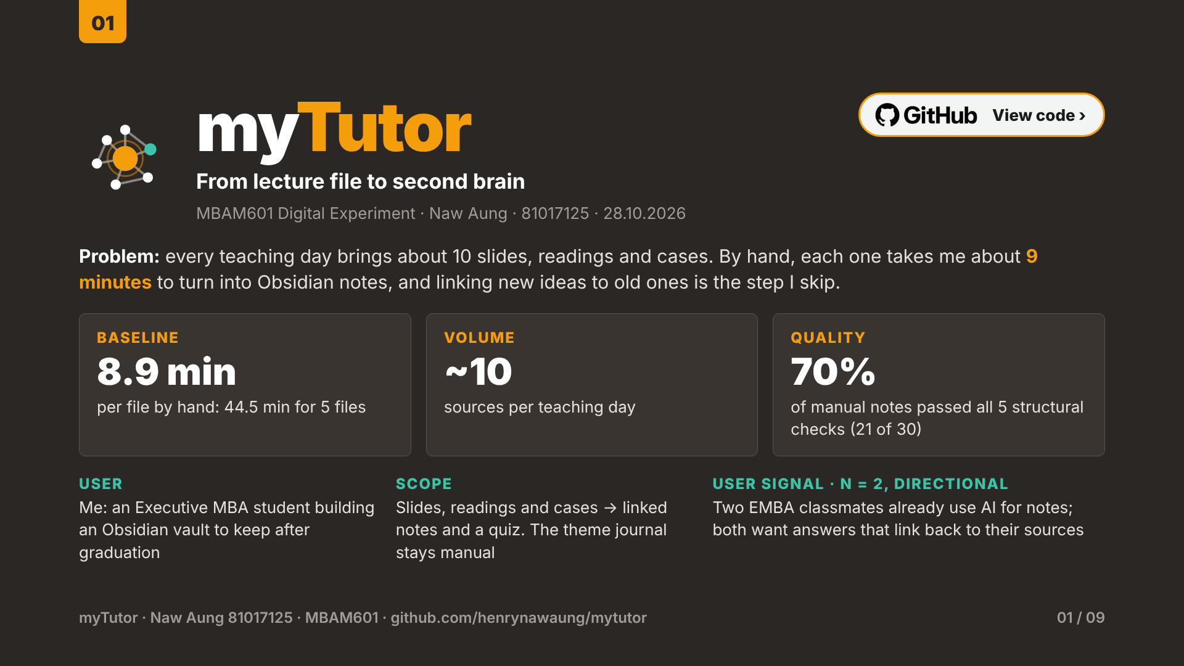
Notes:
myTutor is my digital experiment. The task is narrow and frequent: every teaching day brings about ten slides, readings and cases, and I turn each into linked notes in Obsidian, my knowledge base. In a timed five-file baseline, doing this by hand took 44.5 minutes, about nine minutes a file, and 30 percent of the manual notes failed at least one of my five structural checks, mostly missing links to earlier notes. The user is me; I also asked two EMBA classmates three questions. Both already use AI for notes and both want answers that link back to sources, which is a directional signal only, since two people cannot show broad demand. The theme journal, my own weekly reflection, is out of scope on purpose.
Code and documentation: https://github.com/henrynawaung/mytutor

Slide 2
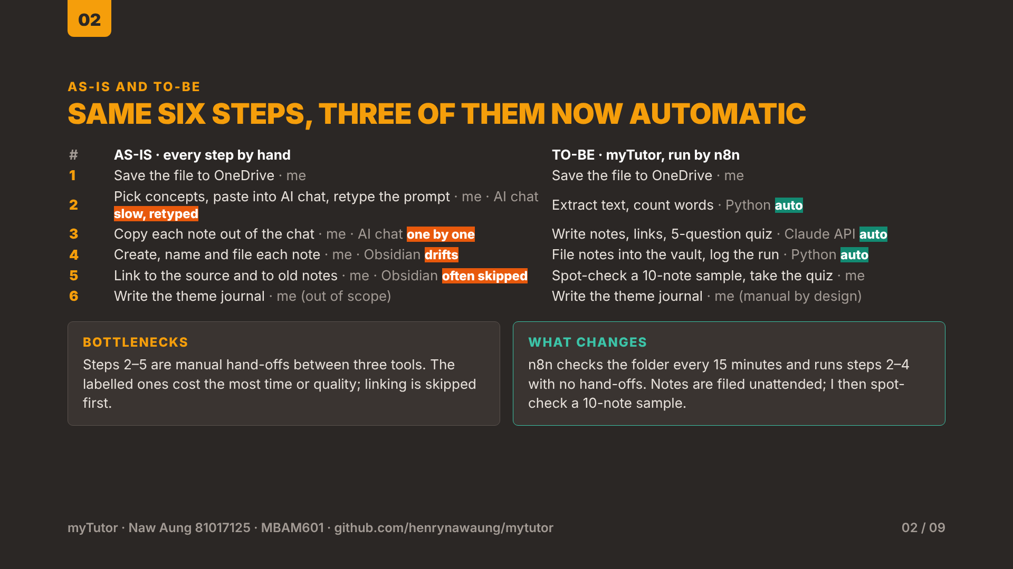
Notes:
On the left is my current process, on the right the same six steps with myTutor. Every as-is step is mine and passes through three tools: OneDrive, an AI chat and Obsidian. Steps two to five are the bottlenecks: I retype the prompt each time, copy notes out one by one, file and name them by hand, which drifts, and linking to the source and to earlier notes is the step I skip when tired. In the to-be process I only save the file. n8n checks the folder every 15 minutes and runs the Python pipeline: text extraction, note and quiz writing through the Claude API, and filing into the vault with a run log. Filing is unattended; afterwards I spot-check a ten-note sample and take the quiz. The theme journal stays manual by design, because writing my own reflection is where the learning happens.
Code and documentation: https://github.com/henrynawaung/mytutor

Slide 3
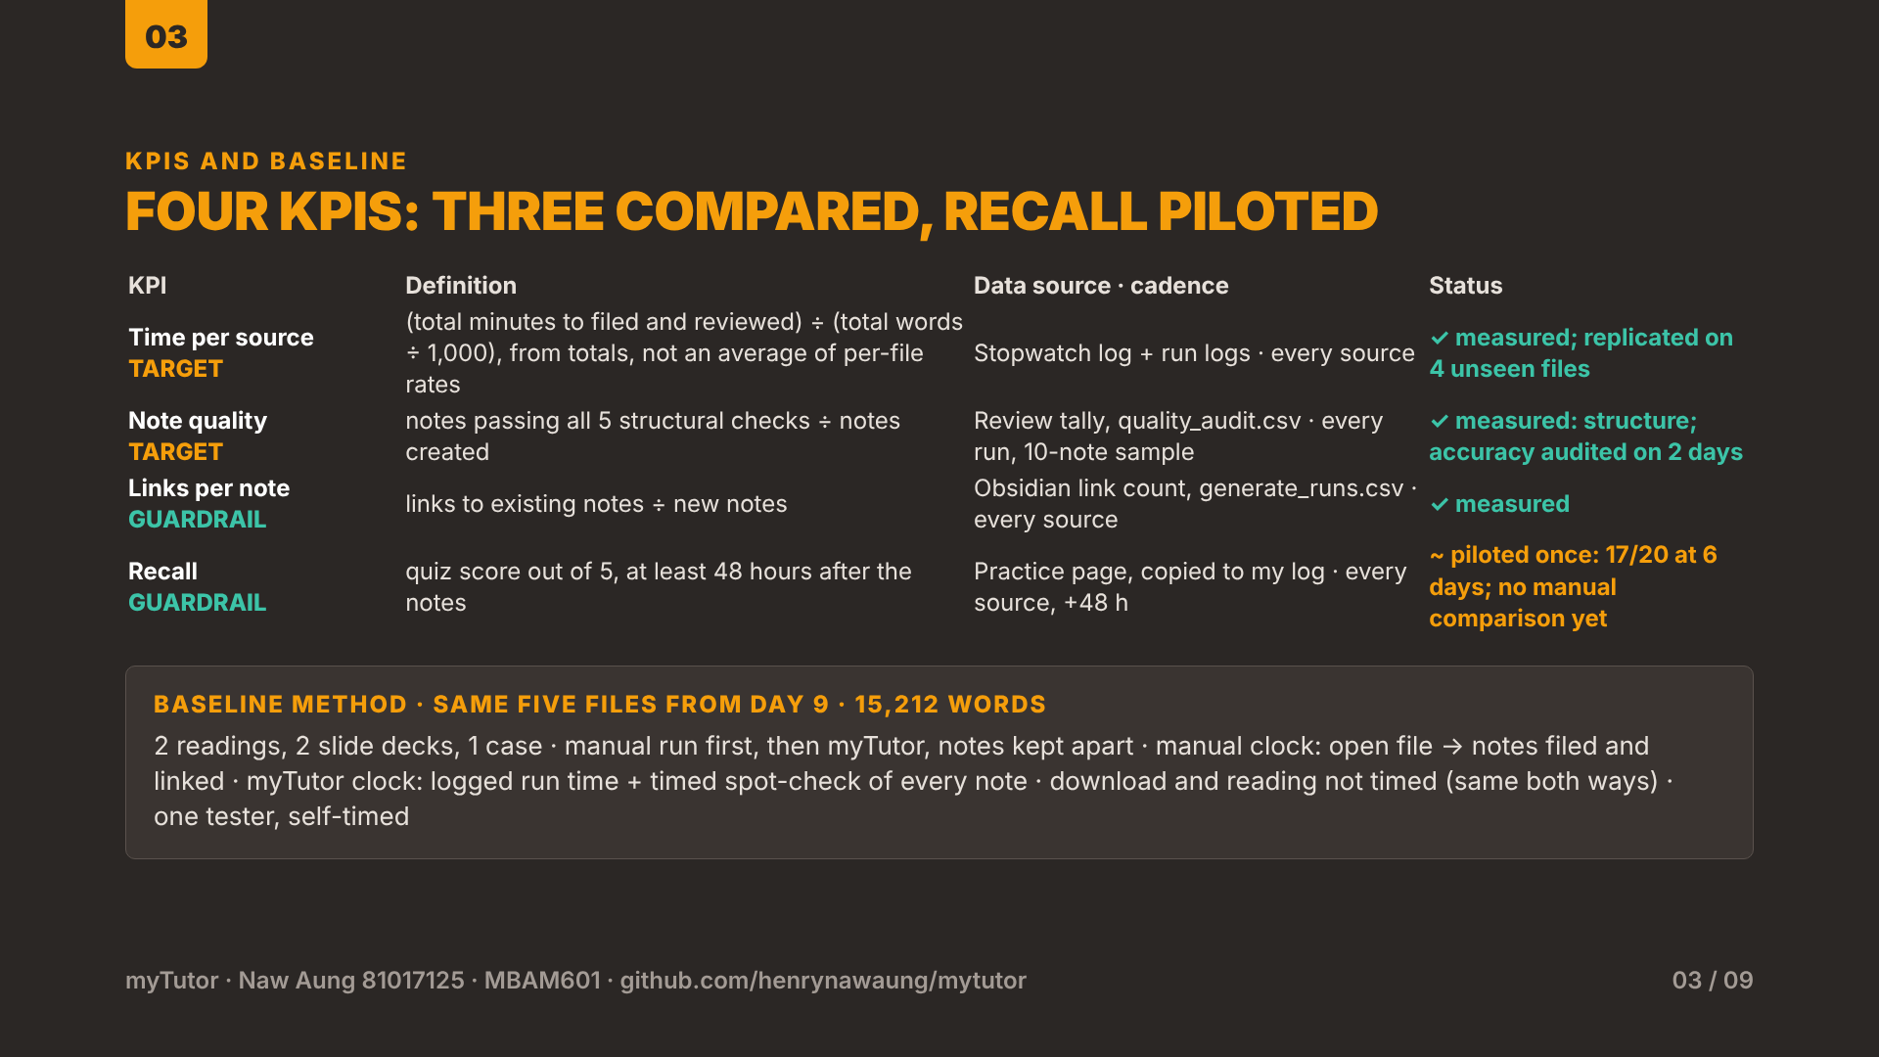
Notes:
Four KPIs, all controllable by me and logged automatically or in my test workbook. Two are targets, the gains myTutor aims for: time per source, normalised per thousand words using totals rather than an average of per-file rates so the shortest file does not dominate; and note quality, the share of notes passing all five structural checks. Two are guardrails, checks that faster notes still help me learn: links to existing notes per note, and recall, a five-question quiz score 48 hours after the notes. Recall was piloted once, not yet compared: six days after the Day 9 notes were made, I scored 17 out of 20 on the Day 9 practice set from memory, 4.25 out of 5. The baseline used the same five Day 9 files both ways: about 15,200 words across two readings, two slide decks and a case. I did the manual run first and the myTutor run after, with notes kept apart. The manual clock ran from opening the file to notes filed and linked; the myTutor clock is its logged run time plus my timed spot-check of every note.
Code and documentation: https://github.com/henrynawaung/mytutor

Slide 4
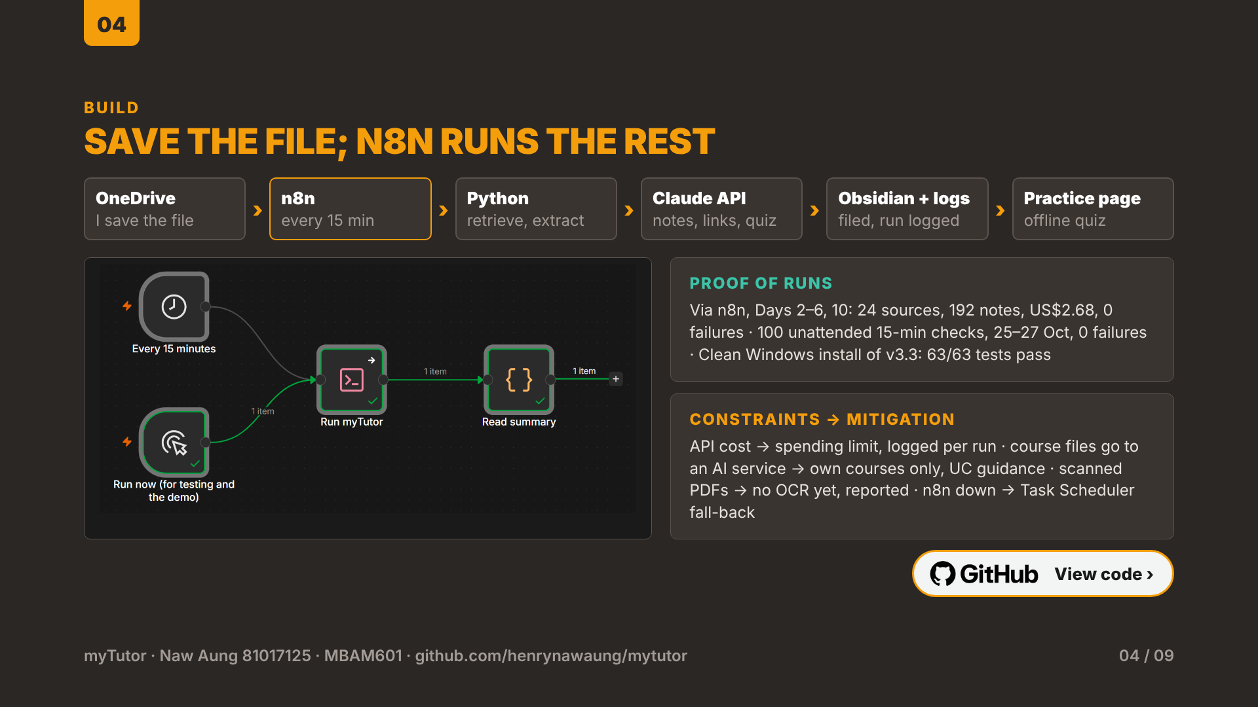
Notes:
The build is a Python pipeline orchestrated by n8n on my laptop. I save a file into my course folder in OneDrive. n8n checks the folder every 15 minutes and runs run.py, which retrieves the new files, extracts their text, calls the Claude API once per source for notes, links and five quiz questions, files the notes into my Obsidian vault without overwriting my edits, logs the run, and rebuilds the offline practice page. Finished files are recorded, so nothing is paid for twice. Proof from the logs: through n8n, Days 2 to 6 and Day 10, 24 sources in all, became 192 notes for 2.68 US dollars with no failures. To be precise, the runs that processed files were ones I started from n8n; separately, the published 15-minute schedule ran unattended 100 times between 25 and 27 October with no failures, each time checking the folder and correctly finding nothing new. Constraints: API cost is capped by a spending limit and logged; course files go to an AI service, so I process only my own courses and follow UC guidance; scanned PDFs need OCR, which is not built yet; and if n8n is down, Windows Task Scheduler runs the same command. To check that someone else could set it up, I cloned version 3.3 from GitHub into a clean folder on Windows, installed the pinned versions in a fresh environment, and all 63 unit tests passed.
Code and documentation: https://github.com/henrynawaung/mytutor

Slide 5
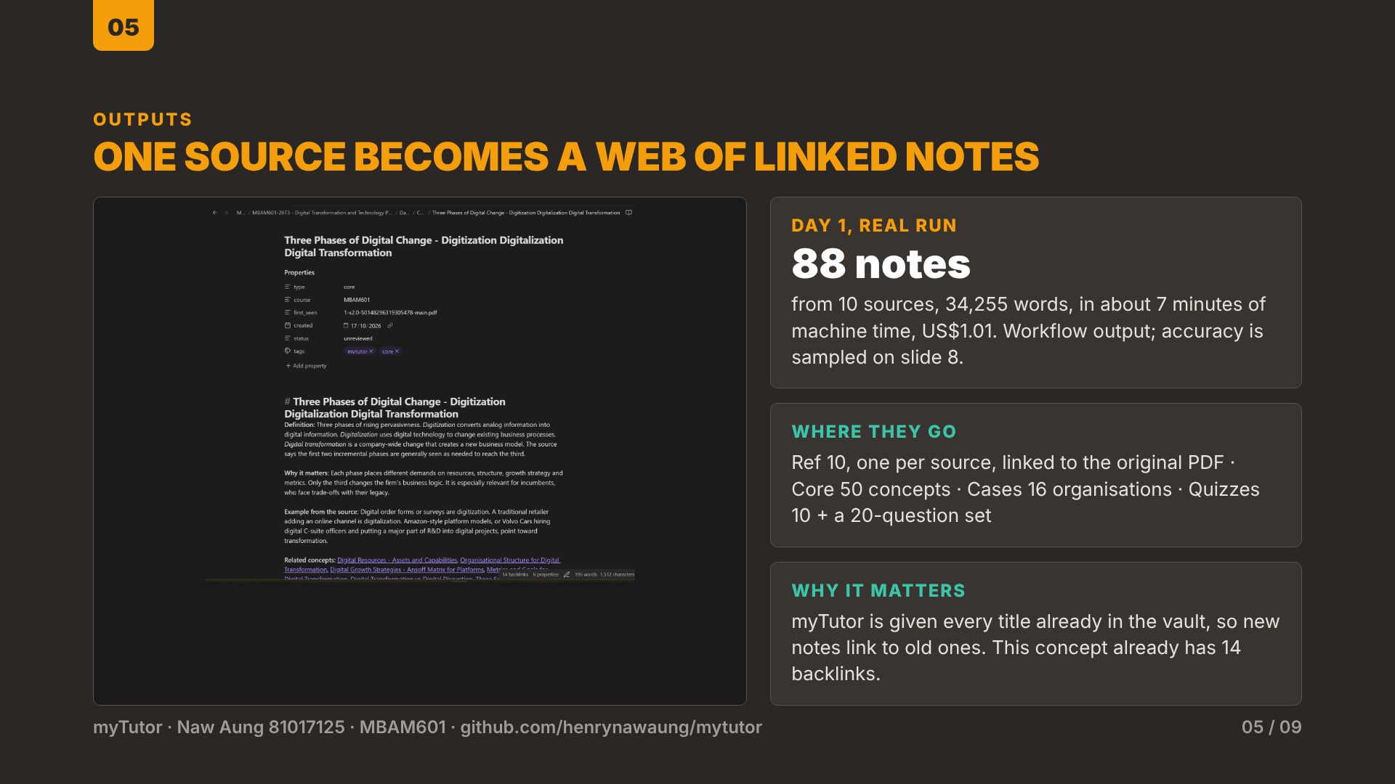
Notes:
This is real output. On Day 1, ten sources, about 34,000 words, became 88 notes in about seven minutes of machine time for one US dollar of API use. Each source gets a reference note that summarises it and links to the original PDF, so every note is traceable. Then one note per key concept in Core, one per organisation in Cases, and a quiz note. Because myTutor is given every note title already in my vault, new notes link to existing ones rather than duplicating them: the concept on screen already has 14 backlinks from other notes. This shows the workflow working; it is not proof that every note is factually correct, which is why I separate structural checks from a factual-accuracy audit on slide 8.
Code and documentation: https://github.com/henrynawaung/mytutor

Slide 6
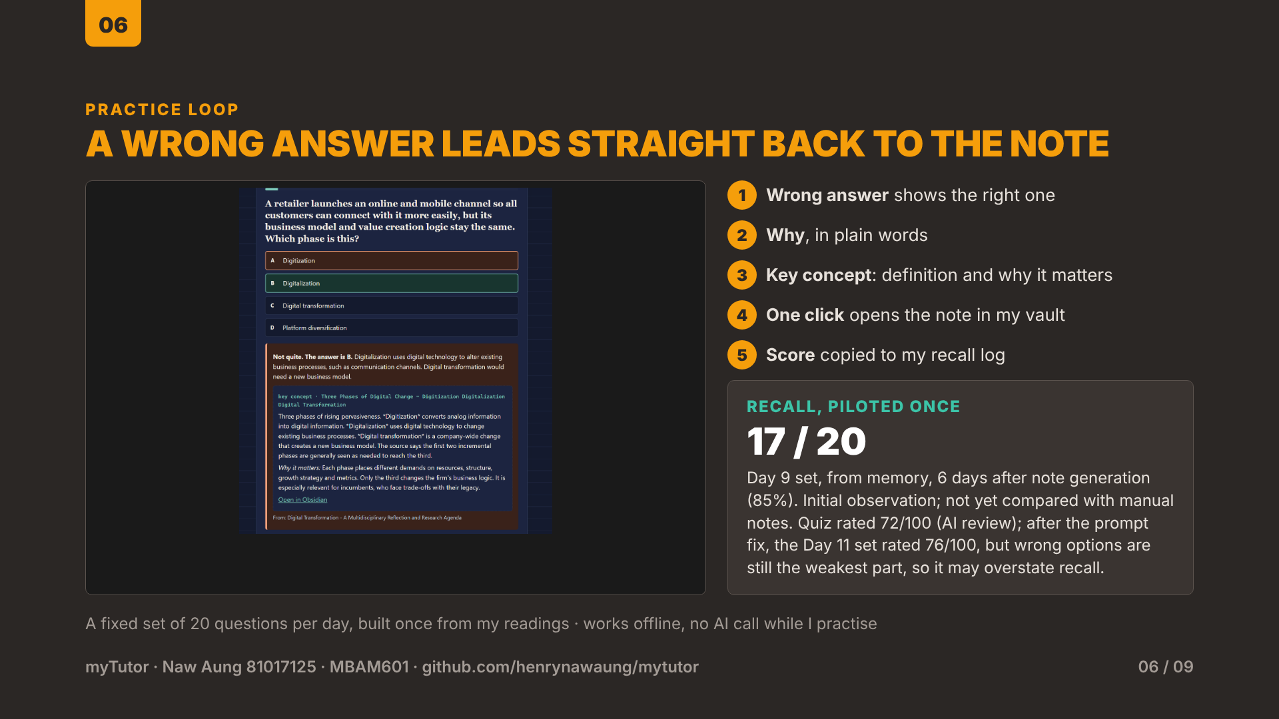
Notes:
myTutor also builds a practice page: a fixed set of 20 questions per teaching day, drawn from the quiz notes, which works offline with no AI call while I practise. When I get an answer wrong, it shows the right answer, explains why, gives the key concept, and opens the source note in Obsidian in one click. This is the feature both classmates asked for. For the recall KPI, I took the Day 9 set from memory six days after the notes were made, well past the 48-hour mark, and scored 17 out of 20, 85 percent. I want to be careful about the claim: that is one test by one person, with no comparison yet against notes made by hand, so it shows the guardrail holding, not that myTutor improves learning. For context, my usual range on quizzes after studying my own manual notes is 17 to 19 out of 20, so this result sits within it. That is an informal impression, not a logged or like-for-like comparison, so it suggests recall did not drop, but it does not prove it. The next experiment is that comparison. I also had the question set rated by a separate AI review as a provisional check of quiz quality: 72 out of 100, strong on topic coverage and accuracy, weakest on distractors, the wrong options, at 5 out of 10; question by question it averaged 7.2 out of 10, ranging from 6 to 8, which means a student can sometimes reach the right answer by elimination without knowing the theory. The review also found 11 of the 20 correct answers were option B. So 17 out of 20 may overstate recall. I fixed one issue and retested it, answer-position balance only: the practice page now shuffles answer positions. On the real Day 9 set, an automated browser took the quiz 20 times with the old page and 200 times with the new one. Before, B was correct in 55 percent of questions every time; after, it was 24 percent, with A, C and D at about 25 percent each, and choosing the right answer still scored 20 out of 20 in every run. That is the pattern for the other fixes: the prompt now asks for plausible wrong options and a mix of recall, application and analytical questions, and I retested it on 1 November: the 20-question Day 11 set, made with the new prompt from four fresh files, was rated by the same kind of AI review. It scored 76 out of 100 against 72, strong on source grounding and scenarios, but distractors still need work: some wrong options are clearly weaker, correct answers tend to be longer, and one question gave a clue to another. So the prompt change helped a little but did not solve distractors, and the next fix is a separate quality-check step that rewrites weak options and checks option length and leakage before the quiz is saved. Shuffling fixed the answer positions; it does not by itself make distractors more convincing.
Code and documentation: https://github.com/henrynawaung/mytutor

Slide 7
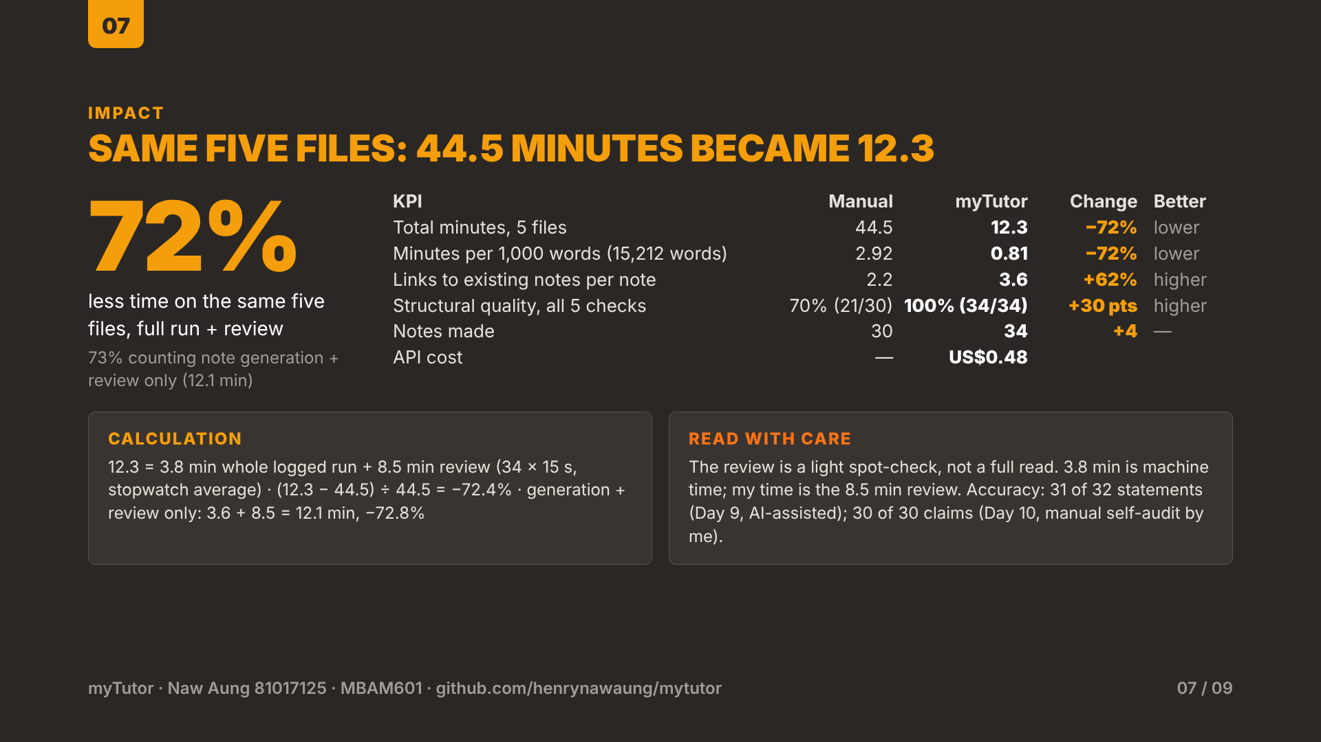
Notes:
On the same five Day 9 files, manual processing took 44.5 minutes. myTutor took 3.8 minutes for the whole logged run, including extraction and filing, plus 8.5 minutes of my timed review, 15 seconds per note on average across 34 notes, so 12.3 minutes in total: a 72 percent reduction. That is the conservative end-to-end figure, so it is my headline; counting note generation and review only, 3.6 plus 8.5 minutes, it is 12.1 minutes and 73 percent. Normalised on the 15,212 words, that is 2.92 against 0.81 minutes per thousand words, using totals. myTutor's notes link to existing notes 3.6 times per note against 2.2 by hand, 62 percent more on the unrounded figures. All 34 myTutor notes passed the five structural checks, against 21 of 30 manual notes, an increase of 30 percentage points. The five files cost 48 US cents. Two cautions: the 3.6 minutes is machine time, so my own time is the review; and the review is a light spot-check, not a full read. Quality here means the five structural checks; separately, an accuracy sample of the ten audited Day 9 notes found 31 of 32 statements supported by the source, and a manual self-audit of Day 10, which I did myself without AI help, found 30 of 30 claims supported.
Code and documentation: https://github.com/henrynawaung/mytutor

Slide 8
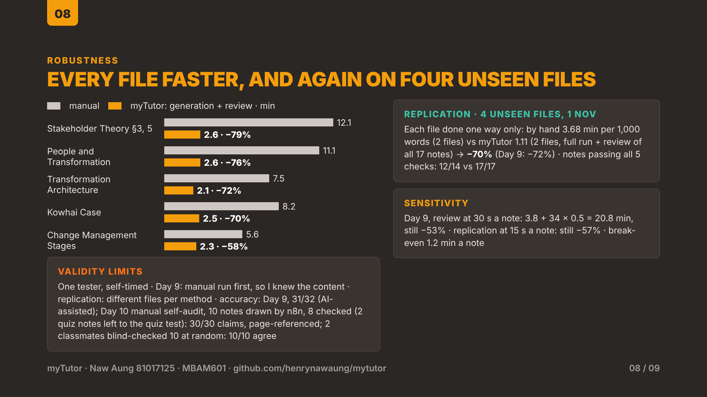
Notes:
Each pair of bars is one file: the upper, lighter bar is the manual time; the lower, orange bar is myTutor's note generation plus my review, the per-file basis of the 73 percent figure; the end-to-end total adds 0.2 minutes of extraction and filing. Every file was faster. The gain is largest on long or dense files, 79 percent on the book sections, and smallest on the shortest file, a 350-word reading, at 58 percent, because review time grows with the number of notes, not the length of the file. The sensitivity check: if review took 30 seconds a note instead of 15, myTutor's full-run total would be 3.8 plus 17, 20.8 minutes, still 53 percent less, and myTutor stays faster unless review exceeds 1.2 minutes per note. The limits: five files, one tester, self-timed; I did the manual run first, so I knew the content when reviewing myTutor's notes, which may favour myTutor; file lengths vary widely; and quality was first checked for structure. I then checked accuracy on the ten sampled Day 9 notes: 32 statements compared with the extracted source text, with Claude's help. 31 were supported by the source; one note added an interpretation that the case does not state. I then re-checked seven of those rows myself against the original PDFs and slides, including the disputed one, and agreed with every result. Because the reviewer asked whether the saving holds on fresh material, I repeated the timing on 1 November with four files I had never opened. To remove the familiarity problem, each file was done one way only: two by hand with my baseline prompt and steps, two with myTutor, comparable in length, about 4,000 words a side. By hand took 15.2 minutes for 4,138 words, 3.68 minutes per thousand words. myTutor took 2.0 minutes of logged run plus 2.4 minutes of my timed review of all 17 notes, 4.4 minutes for 3,938 words, 1.11 per thousand: 70 percent less, against 72 percent on Day 9. Even at a 15-second review per note it is 57 percent less. 12 of 14 manual notes and all 17 myTutor notes passed the five checks. The limit is that the files differ between methods, so file difficulty is not held constant; it is one tester on one afternoon. Because the accuracy check was AI-assisted, I then did a manual self-audit of a fresh sample, checking my own tool's output myself, so it is not an independent review. On Day 10, n8n had already drawn ten random notes before I checked anything. I audited the eight case and concept notes, leaving the two quiz notes to the separate quiz-quality test: 30 factual claims, each checked against the original article with a page and column reference. All 30 were supported, with no substantive errors. Two were close paraphrases, for example the source says innovation usually loses out where the note says the core wins. That is two samples, 18 notes across two days, by one reviewer checking his own tool. To make it partly independent, two classmates, Shawn and Faiiz, each checked five of the 30 claims, drawn at random, against the original readings without seeing my ratings, and both rated all five supported, so 10 of 10 agree. That strengthens the result rather than proves it, and the sample happened to contain no reference notes.
Code and documentation: https://github.com/henrynawaung/mytutor

Slide 9
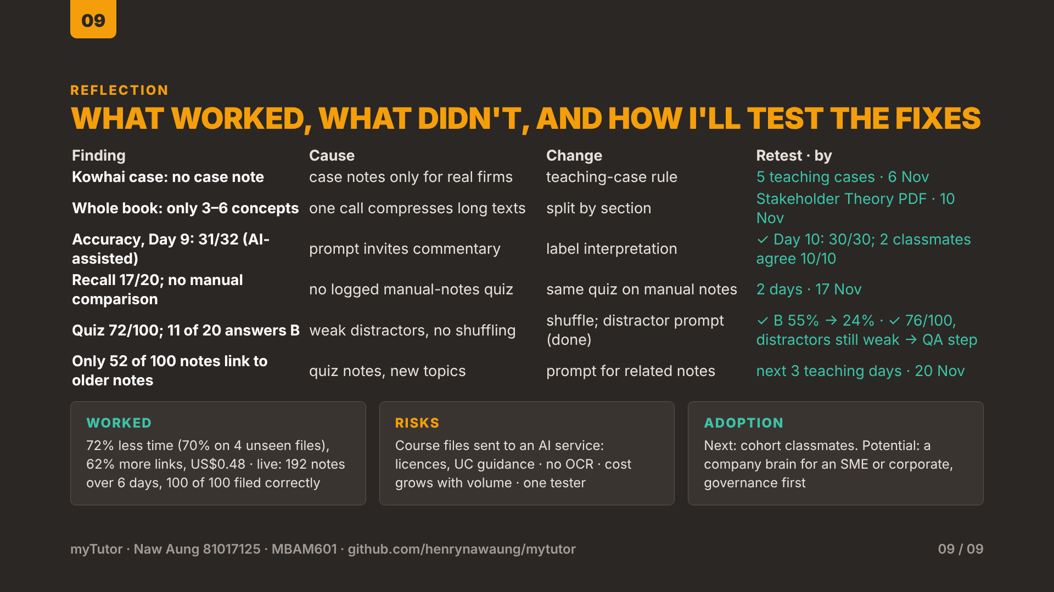
Notes:
What worked: on five files, 72 percent less time, replicated at 70 percent on four unseen files, 62 percent more links to existing notes, every note passing the structural checks, for 48 cents, and in live use since 25 October it has turned 24 sources from six teaching days into 192 notes, with every one of 100 audited notes in the right folder with complete properties. Each failure has a cause and a testable fix. The Kowhai case got no case note because the prompt writes case notes only for real organisations, so I will add a rule for teaching cases and retest on five cases. A whole book as one file gave only three to six concepts because one call compresses a long text, so I will split readings by section and compare concepts per section. An accuracy check of the ten sampled Day 9 notes found 31 of 32 statements supported by the source; one added an interpretation the case does not state, because the prompt invites a 'why it matters' comment, so interpretation will be marked as analysis. Because that check was AI-assisted, I did a manual self-audit of a Day 10 sample, against the original articles with page references: 30 of 30 claims across eight notes were supported, and two classmates who blind-checked ten of them agreed on all ten. Recall held up, 17 out of 20 from memory six days later, but with nothing to compare against, so I will run the same test on notes made by hand, and add new questions on the same concepts in different scenarios, to test transfer rather than recognition. 85 percent on this quiz is not 85 percent mastery. A provisional AI review rated the quiz 72 out of 100, weakest on distractors. I changed the prompt and retested on the fresh Day 11 set: 76 out of 100, a small gain, with distractors still the weakest part, so the prompt alone was not enough and the next change is an automatic quality check on each quiz. And the live audit of 100 sampled notes found only 52 linking to an older note, likely because quiz notes and new topics have few older notes to link to, so I will measure concept notes only, prompt for related notes, and re-audit. Risks: course files go to an AI service, so licences and UC guidance apply; there is no OCR yet; cost grows with volume; and the evidence is from one tester. Adoption: next, classmates in my cohort. Longer term the same pattern could become a company brain for an SME or a corporate, where access control and governance would come before the AI.
Code and documentation: https://github.com/henrynawaung/mytutor

